Slide 1
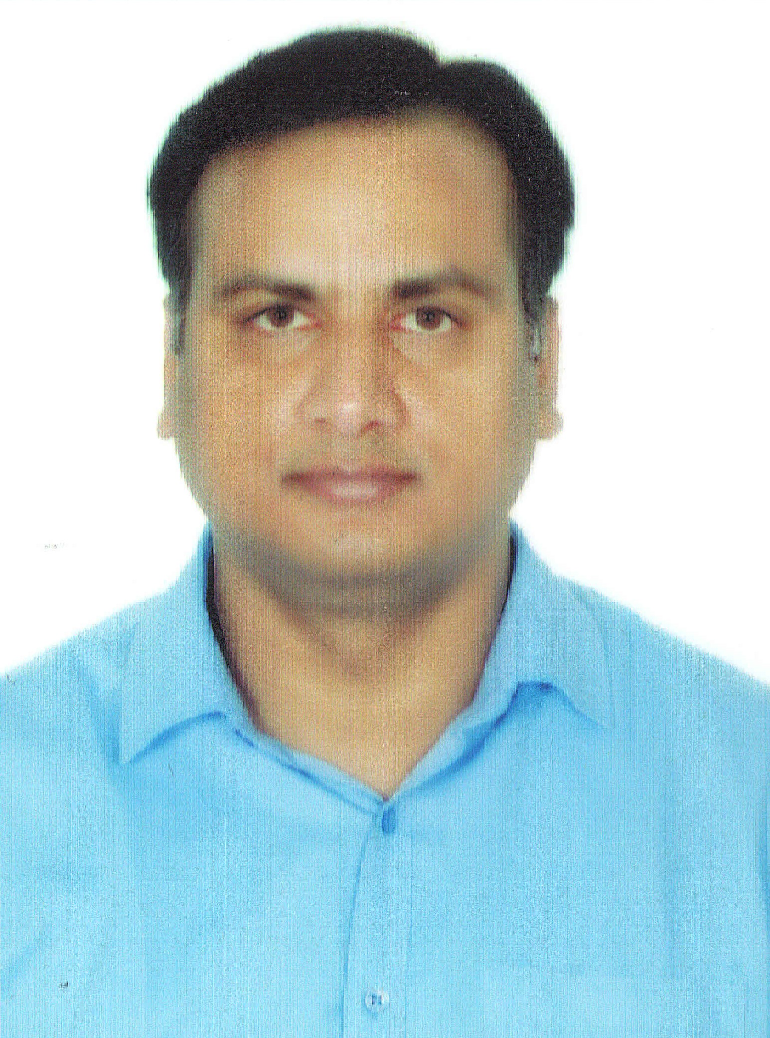
Soma Shankar Naik Vadthya, Senior Technical Architect, Salesforce
soma.vadthya@brillio.com
Senior Architect,
Hyd , Ind
Professional Summary
Over 17 years of experience in the IT sector with 16+ years in the Salesforce ecosystem.
Expertise in Salesforce architecture, development, and administration.
Extensive experience in integrating Salesforce with other applications.
Proven track record of delivering enterprise-grade solutions for Sales and Service organizations.
Strong leadership skills with experience leading cross-functional teams.
Proficient in data analysis and visualization using tools like Tableau.
Skilled in agile methodologies and full software development lifecycle (SDLC).
Effective communicator with strong interpersonal and problem-solving skills.
Proficient in providing technical architecture and solution architecture for complex enterprise projects.
Experienced in TOGAF principles and enterprise architecture frameworks.
Skilled in designing scalable and robust systems to meet business requirements.
Core Skill Sets
Salesforce Architecture & Development: Apex, SOQL, Salesforce Lightning, Integrations.
Enterprise Solutions: System Architecture, Domain-driven Design, Design Patterns, Frameworks.
Project Management: Agile Methodologies, SDLC, Team Leadership, Requirement Analysis.
Certifications
Salesforce Certified Administrator.
Sales Cloud Consultant
Service Cloud Consultant
Project Experience
Brillio
Role: Senior Technical Architect.
Key Contributions: Currently leading the design and implementation of Salesforce solutions, providing technical leadership, and ensuring alignment of Salesforce functionalities with business requirements.
LTIMindtree
Role: Principal Architecture.
Client: Google.
Key Contributions: Led the design and implementation of Salesforce solutions, provided technical leadership, and ensured the alignment of Salesforce functionalities with business requirements.
Recent Roles
Senior Technical Architect at Brillio (Feb '24 – Present)
Principal Architect at LTIMindtree (Nov '22 – Feb '24)
Salesforce Architect at Align Technology (Mar '20 – Nov '22
Key Clients
Google
VMware
Lucid Motors
HP
©2024 Brillio | 1

Slide 2
Soma Shankar Naik Vadthya, Senior Technical Architect, Salesforce
Align Technology
Role: Technical Architect.
Key Contributions: Led design and implementation of Salesforce solutions, provided technical leadership, developed scalable business processes, contributed to design sessions, and trained internal resources.
Evoke Technologies
Role: Technical Architect and Salesforce Practice Lead.
Key Contributions: Developed SFDC practice roadmap, led pre-sales and RFP processes, implemented various Salesforce clouds, ensured security best practices, conducted POCs, and trained developers.
Accenture
Role: Technical Lead.
Client: VMware.
Key Contributions: Architected and designed SFDC sales and service projects, led multiple development teams, integrated Salesforce with Amazon S3 and SAP HANA, and mentored team members and did code reviews.
Deloitte
Role: Senior Developer Salesforce
Key Contributions: Designed and developed SFDC applications, conducted sprint planning, led a team of developers, prepared technical design documents, integrated Salesforce with Tableau and Exact Target.
Wipro
Role: Salesforce Admin.
Key Contributions: Managed email marketing campaigns, ensured data integrity, configured Salesforce, created reports and dashboards, automated reporting processes
©2024 Brillio | 2

Slide 3
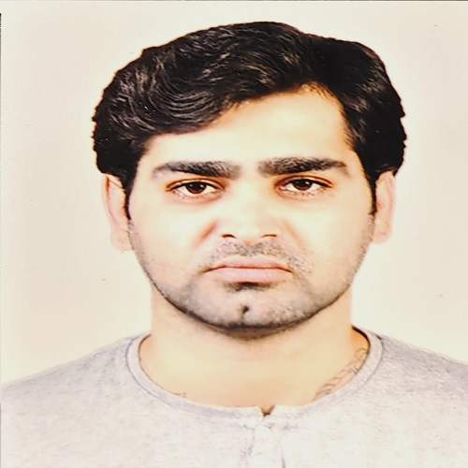
Sohil Kharwar, Development (Salesforce)
Salesforce Sr. Lead Engineer with more than 10 years of industry experience
Proficient in Salesforce Development, Apex, Lightning Web Components, Salesforce integrations, Flows and some of other Admin tools.
Experienced with Copado and Gearset for continuous Integration, deployment and release management.
Sohil.Kharwar@brillio.com
Bangalore, Ind
Core Skill Sets
Experienced in development in different tools in salesforce
Experienced with standard practices, reusable code and scalable structure.
Experienced with different tools used for development and deployment.
Project Experience
Sprinklr
Role: Sr. Salesforce Developer
Responsibilities:
To work on tickets to support end user keep processing seamlessly.
Do requirement and code analysis to complete enhancements required in client system efficiently.
Doing unit testing for the changes I've done and hold the responsibility for my changes till they're deployed to production.
Connecting with requestors to discuss requirement, help them to complete UAT if needed and get the sign off to deploy on production.
Writing down solution drafts and get it reviewed by other team members before working on development.
Preparing technical document for the changes I've made.
iRhythm
Role: Salesforce Developer
Responsibilities:
Analyzed existing code and find the optimal solutions for the requirement mentioned in helpdesk tickets.
Doing admin/dev work as and when need to achieve the requirement.
Doing unit testing and thorough testing for the build.
Helping users to complete the UAT.
Preparing technical document and test script for scenarios as part of requirement.
Certifications
Salesforce Platform Developer 1
Recent Roles
Sr. Salesforce Developer
Salesforce Developer
Key Clients
Sprinklr
iRhythm
Ceredian
EWB
©2024 Brillio | 3

Slide 4
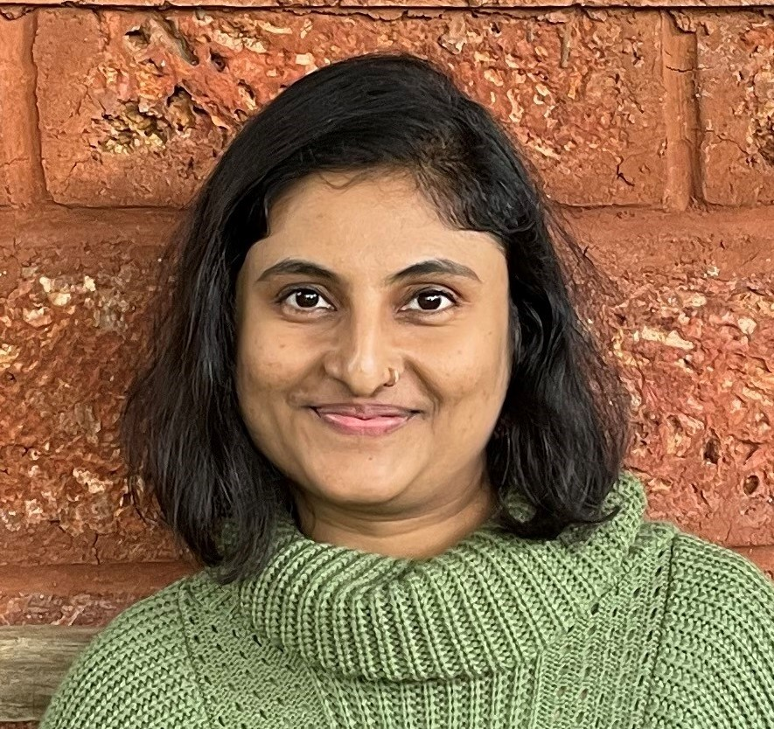
Apurva Lale, Assistant Project Manager
14 years of experience in IT field comprising of 8 years technical and 6 years of leading cross functional teams.
Certified Scrum Master helping teams by resolving impediments and facilitating ceremonies.
Experience in JIRA, Service Now and Confluence to track the progress and maintain transparency.
Agile Project Manager with experience in managing projects from initiation to closure.
Apurva.lale@brillio.com
Pune, Ind
Project Experience
Leaf Home: Integrations with Other Systems
Managing resources and capacity
Facilitating scrum ceremonies
Tracking progress by utilizing project management software like JIRA, Service Now, Confluence
Managing project risks, issues, and dependencies
Delivering weekly status reports highlighting key project metrics
Emerald : Application Support
Managing resources
Scrum process improvements along with scrum artifacts
CMMI documentation
Managing project, Risk/Issues/Dependency Management
Zscaler: Salesforce Sales, Service, CPQ clouds
Managing resources
Facilitation of scrum ceremonies
Scrum process improvements along with scrum artifacts
CMMI documentation
Managing project, Risk/Issues/Dependency Management
Core Skill Sets
Scrum
Kanban
Agile Project Management
JIRA
Confluence
Salesforce
CMMI
Certifications
Salesforce Certified Administrator
Certified Scrum Master
SAFe 5.0 Certified Scrum Master
Recent Roles
Scrum Master
Project Manager
Key Clients
Zscaler
Emerald
LeafHome
©2024 Brillio | 4

Slide 5

Bharati Nagrale, Scrum Master PMO
Professional Summary
Experienced operations and project management professional with expertise in Agile methodologies, stakeholder management, and project coordination.
Skilled in facilitating communication and driving organizational change. Proficient in Scrum framework, risk management, and fostering team collaboration. Strong track record of optimizing processes and delivering successful projects.
Skilled in requirement gathering, risk management, and financial analysis, making sure projects are delivered on time and within budget.
Proficient in tools like JIRA, Tableau, and Power BI, I have a solid technical foundation and am certified as a SAFe Agile Scrum Master. With a focus on streamlining processes and optimizing efficiency, I bring a wealth of experience in driving successful project outcomes.
Bharati.nagrale@brillio.com
Pune, IND
Industry Experience:
2 Yrs Brillio :PMO –Senior Operations Associates
Core Skill Sets
Agile Methodology
Project Management
Stakeholder Management
Change Management
Risk Management
Scrum Framework
Facilitation
Communication and Team Collaboration
Continuous Improvement
Project Experience –Senior Operations Associates
Client : MOVE , Dayforce ,Rubrik
Facilitated Agile ceremonies including Daily Stand-ups, Sprint Planning, Sprint Reviews, and Retrospectives for cross-functional teams within Brillio Technologies.
Coached and guided teams on Agile principles, practices, and frameworks, ensuring adherence to Scrum methodologies.
Fostered a collaborative and self-organizing team environment, empowering members to take ownership and accountability for sprint commitments.
Removed impediments and blockers hindering team progress, enabling continuous delivery and iterative improvement.
Supported teams in estimating and forecasting sprint work, promoting transparency and predictability in project delivery.
Maintained and updated Agile tools and artifacts, such as JIRA, ensuring accurate and up-to-date information for effective decision-making.
Acted as a servant leader, promoting open communication, trust, and respect among team members to enhance collaboration and productivity.
Facilitated cross-team coordination and alignment, resolving dependencies and promoting knowledge sharing across departments.
Conducted regular retrospectives to identify areas for improvement and implement action plans to enhance team performance and effectiveness.
Collaborated with stakeholders to understand project requirements and expectations, ensuring successful project delivery and customer satisfaction.
Certifications
SAFe Agile Scrum Master
Salesforce Admin
Certified Business Analyst Professional (CBAP) IIM &EY
Project management essential certificate
Tools- JIRA, Power BI, Python (Basics)
Flosum Fundamental
Generative AI and Its Impact everyday Business
Microsoft project 2016
©2024 Brillio | 5

Slide 6
Bharati Nagrale, Scrum Master -PMO
Managed and optimized project management office (PMO) activities at Brillio Technologies, ensuring alignment with organizational goals and objectives. Spearheaded the development of governance reporting practices, enabling timely decision-making and progress measurement. Facilitated clear communication and collaboration among stakeholders to enhance project performance and delivery
CBRE South Asia Pvt Ltd, Pune, India
Led Agile methodologies as a Scrum Master, driving cross-functional teams towards successful project deliveries within CBRE South Asia Pvt Ltd. Orchestrated Agile ceremonies and coached teams on best practices, fostering a culture of collaboration and continuous improvement.
Ensured alignment between product development and business objectives, while mitigating impediments to maximize productivity and efficiency.
Pegasus Properties Pvt Ltd, Pune, India
Applied Agile principles and methodologies as a Scrum Master at Pegasus Properties Pvt Ltd, overseeing project execution and fostering collaboration among multidisciplinary teams.
Guided teams through Agile ceremonies and facilitated continuous improvement through retrospectives. Maintained alignment with project objectives and stakeholder expectations, ensuring timely delivery of high-quality results.
Simplilearn Certification Project : WhatsApp Pay Project
Led requirements gathering and analysis efforts for the WhatsApp Pay project, ensuring alignment with business objectives and user needs.
Collaborated with stakeholders to define functional and non-functional requirements, facilitating the development of a comprehensive scope document.
Conducted SWOT analysis to identify project risks and developed mitigation strategies to ensure successful feature implementation. Utilized various tools to visualize system interfaces and business requirements, ensuring clear communication and alignment across the project team. Contributed to the enhancement of WhatsApp Pay features by identifying key development priorities and streamlining the software development process.
Simplilearn certification :Canteen Ordering system
Led the Simplilearn project for the development of a Canteen Ordering System, employing analytical skills to enhance user experience and operational efficiency.
Identified project stakeholders and conducted a comprehensive analysis of the existing system to define project objectives. Developed detailed process maps and scope documentation, ensuring a clear understanding of system functionalities.
Utilized flowcharts and ER diagrams to represent data structures and system processes accurately.
Compiled comprehensive business requirements, encompassing both functional and non-functional aspects, to guide system development.
Employed wireframing tools to visualize system interfaces, facilitating stakeholder alignment and feedback.
Contributed to the successful implementation of the system by ensuring thorough requirements analysis and effective communication throughout the project lifecycle.
©2024 Brillio | 6

Slide 7
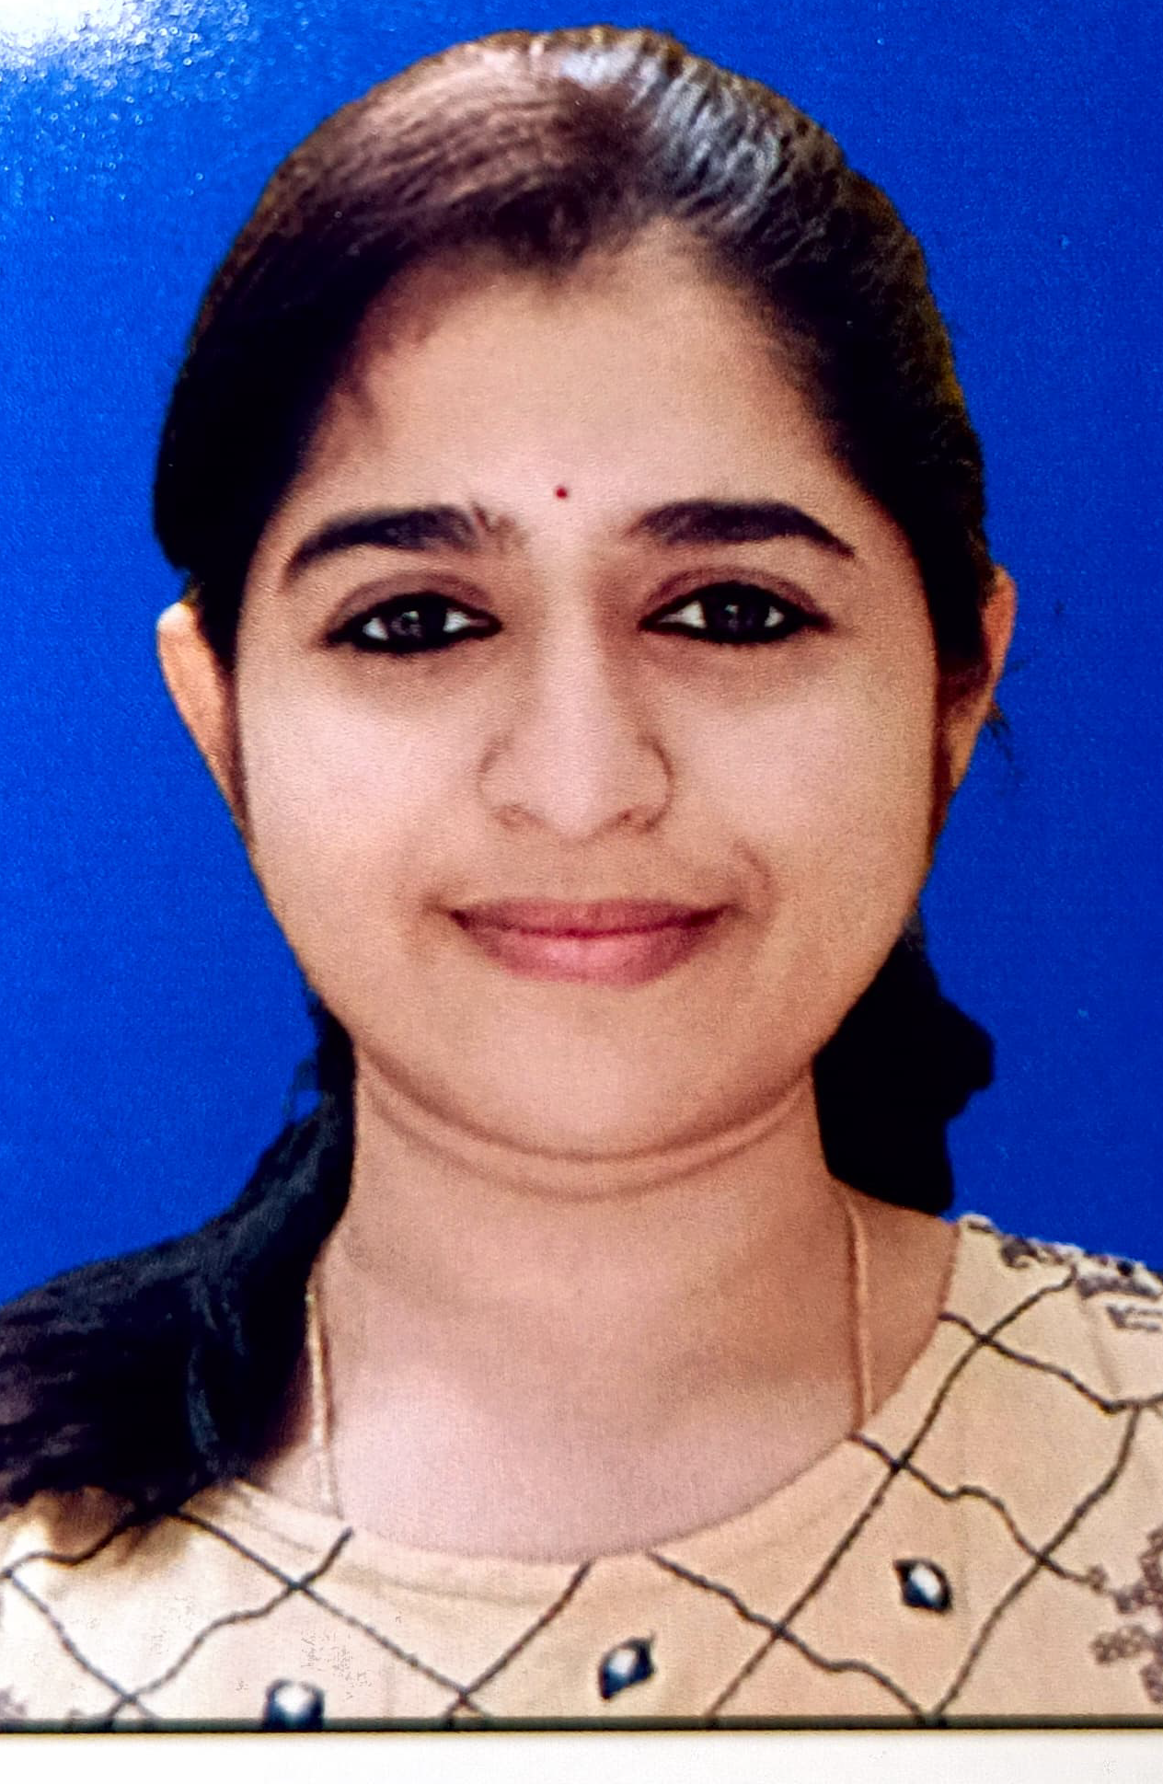
Bhavani Sarikonda Consultant, Devops (Salesforce, copado)
Having 4 years of experience in salesforce worked in both configuration and Devops.
Hands-on experience in the Copado deployment and completed certification in flosum.
Ability to multi-task work across different applications and diverse work experience with different functionalities of the application.
Excellent team player, self-motivated, quick learner with good communication skills and trouble - shooting capabilities.
Bhavani.sarikonda@brillio.com
Core Skill Sets
Experienced in deploying projects to various environments to production.
Extensive experience with Analysis, deployment, Implementing the code to various environments.
Experienced in working across various teams to deploy their projects
In Depth Experience in Flosum and Salesforce CPQ.
Project Experience
Google
Involved mainly in deployment process.
Work closely with developers to build their development pipeline and deploy code to various environments.
participate in deploying, automating, maintaining and merging code in to various environments .
Executed various salesforce tasks (pre and post deploy) in order to configure the respective salesforce environments for the deployment and configure as per the business needs after deployment .
proactively communicate and coordinate with multiple project teams.
working closely with developers on developing and supporting new features.
Ciena
Hands-on experience in the implementation and configuration of CPQ systems
Extensive experience in configuration of various CPQ constructs like product modeling, Bundles, attributes ,product rules, Summery variables, price rules and facing documents(templates).
Certifications
Salesforce Copado Fundamentals 1 Certifiction
Salesforce Copado Fundamentals 2 Certifiction
Flosum Professional Certifiction
CPQ Specialist Certification
Recent Roles
Salesforce DevOps RE
Salesforce CPQ Specialist
Salesforce Lead Developer.
Key Clients
Google
Ciena
Confluent
©2024 Brillio | 7

Slide 8

Gitesh Kumar, Development and DevOps(Salesforce, Copado, Flosum)
Professional Summary
Seasoned Salesforce DevOps Leader with more than 4.8 years of industry experience
Proficient in Salesforce Development, encompassing Apex, Lightning Web Components and Salesforce integrations.
Extensive Experience with DevOps practices, particularly using Copado and Flosum for continuous Integration, deployment and release management.
Skilled in version control systems such as Git and continuous integration tools
Proficient in Google SQL and adept at designing and implementing Looker Studio dashboards to facilitate data visualization and analysis
gitesh.kumar@brillio.com
Bangalore India
Industry Experience:
Development, DevOps
Core Skill Sets
Extensive experience in building and managing scalable releases, ensuring timely production releases.
Proficient in the complete lifecycle of CRM applications, including analysis, design, development, customization, and implementation
Experience in working across various Salesforce DevOps tools covering Copado, Flosum, CircleCI
Project Experience
Google LLC: Flosum Implementation and migration
Enhanced Flosum tool to comply with Google Security Standards and its capabilities.
Key responsibilities involve formulating a collaborative strategy among multiple organizations. This includes integrating PMD code checks and implementing continuous monitoring practices, ensuring adherence to Google security standards and onboarding new projects.
Over 30+ production organizations at Google currently utilize the solution.
To analyse data from multiple production organizations, we have created reports outside the Salesforce system using Looker Studio and google proprietary tools.
Google LLC: Consulting and Implementation service related to Salesforce DevOps on Copado
Building and maintaining DevOps process in 100+ Salesforce orgs using Copado.
We were responsible for Streamlining the DevOps process by automation, building pipelines, performing development of quality checks, deployments, managing releases and monitoring orgs.
Strategically planning on how to increase the efficiency and productivity of the system.
Reduced risk and downtime of the system.
Irythm Technologies: Salesforce Classic to lightning migration
We helped iRhythm, upgrading to latest version of Salesforce with new capabilities and by designing a new lightning UI, automating and streamlining their day-to-day processes using lift and shift mechanism.
Developing and deploying new features and solutions to address their business requirements.
UI Processing time improved by 40% and Overall efficiency by 43%.
Certifications
Salesforce Certified Development Lifecycle and Deployment Architect
Salesforce Certified Developer
Salesforce Certified App Builder
Salesforce Certified Administrator
Copado Certified Consultant
Flosum Expert Certified
Recent Roles
Salesforce DevOps Lead
Salesforce Developer
Key Clients​
Google
IRhythm
©2024 Brillio | 8

Slide 9
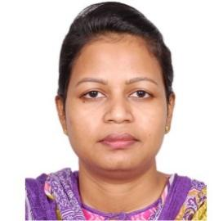
Sudipta Mohapatra, Senior Lead Quality Engineer
Professional Summary
Technology leader with over 10+ years of experience in Manual Testing & 2 years into automation testing
Expertise spanning across diverse industry domains, including Logistics, E-Commerce, Restaurant management , Health Insurance, Enterprise Finance systems, manufacturing etc.
Having manual testing experience of 1 year in Salesforce Sales cloud, CPQ, NetSuite.
Having automation testing experience in selenium web driver, core java, cucumber – BDD framework, Page Object model, TestNG
Spearheaded the development of Test Strategy and test plans reducing system errors by 25%
Skillfully performed manual and automation testing leading to detection of 100+ software glitches.
Lead a team of 5 QA engineers to achieve 95 % positive outcome in software tests.
Sudipta.mohapatra@brillio.com
Bangalore, India
Industry Experience:
Logistics, E-Commerce, Restaurant management, Real Estate, Health Insurance
Core Skill Sets
Have hands on experience in Salesforce Sales Cloud, Order management system (Deck Commerce), Kount, Adyen, Emarsys, Oracle/SF CPQ, Zuora Billing system.
Experience in working with Agile Methodology
Good exposure on STLC with extensive experience on Requirement analysis, Test planning, Test Case Authoring, Peer review of Test scenarios, Test Case execution, Defect Reporting, Tracking and defect triaging.
Have hands on experience in using POSTMAN, Swagger for REST API testing.
Experience automation testing using Selenium webdriver, core java, TestNG, Cucumber- BDD
Project Experience
Toast : RBAM (Role Based Access Management) and SKU
This project involves manual testing of the different products that Toast has to offer along with Salesforce production support involving users, profiles, permission sets, validation rules, queues etc.
Review User stories
Creating Test cases, Test execution for manual testing in Test Rail
Defect reporting using JIRA
Attending daily stand-up calls and giving updates to stakeholders
Being a part of backlog grooming sessions, sprint planning, retrospective meetings etc.
Move Inc. : Listing Promotion (realtor.com)
This project is all about creating products for the customers (brokers/Agents) that will enable them to promote their property on the realtor website for a certain number of days. Testing includes system testing and end to end testing starting from the dashboard in the website to its integration with Salesforce, Oracle CPQ, Tax processing systems like Vertex, Billing systems like Zuora, payment systems etc.
Review requirement documents, Epics, User stories, BRD, figma images etc
Creating Test cases, Test set, Test plan, Test execution for manual testing (web, mobile)
Executing manual test scenarios in salesforce, oracle CPQ, licensing systems, inventory systems, billing systems, tax calculation systems, payment gateways etc.
Defect reporting using JIRA
Being a part of daily stand up calls, backlog grooming sessions, sprint planning, retrospective meetings etc.
Certifications
Salesforce Certified Admin
Recent Roles
Senior Lead QE Engineer
Key Clients
Toast
Move
Anthem
NewBalance
Dubai Ports World
©2024 Brillio | 9

Slide 10
Sudipta Mohapatra, Senior Lead Quality Engineer
Checkout: New Balance Athletics Inc.
New Balance is a major sports footwear and apparel manufacturer that sells products through online storefront in several countries. It also has physical stores in USA.
This project involves both manual and automation testing of the storefront. Manual testing includes testing of the UI along with data flow to several upstream and downstream systems like Salesforce commerce cloud, Order management system (Deck Commerce), Kount, Adyen, Avalara Tax system, Emarsys etc.
Review requirement documents, Epics, User stories, BRD etc.
Creating Test cases, Test set, Test plan, Test execution for manual testing (web, mobile)
Defect reporting using JIRA
Using Applitools (AI-powered visual testing & monitoring platform) for visual testing to identify GUI bugs easily and with greater speed.
Being a part of daily stand-up calls, backlog grooming sessions, sprint planning, retrospective meetings etc.
Dubai Ports World: Cargoes Community System
DPW is building a software called Cargoes Community System for handling Sea Cargo, which they want to integrate with 72 terminals around the globe to track the entire inbound and outbound cargo and the associated processes. This project involves both manual and automation testing of the Mawani software
Creating Test case, Test set, Test plan, Test execution for manual testing (web, mobile, APIs, and database systems)
Involved in manual testing of web application (integration testing, system testing, sanity testing, regression testing etc.)
Involved in manual testing of REST APIs using Postman tool, Swagger
Involved in manual testing of mobile applications using Sauce labs.
Involved in manual testing of Power BI reports
Defect reporting using JIRA
Interacting with the Clients (Terminal Operator technical team) for testing integration between N4 systems and CCS system.
Attending daily stand-up calls and giving updates to stakeholders
Collaborate to define, document, improve and automate processes, track issues to resolution and document changes
Participate in scheduled and ad-hoc deployment activities during business, and off-hours as necessary
Anthem: PIMS(Payment Innovation Management System).
The PIMS Project is about Automation Testing of the various Health Insurance Sections of Anthem.
Creating cucumber (Gherkin Language) test cases in Eclipse
Creating selenium automation scripts for the cucumber test cases in Eclipse using java language
Executing scripts in Eclipse (Individual run using Test Runner and Batch run using POM.xml)
Generating Cucumber reports and sending to stakeholders.
Attending Scrum calls and giving updates to stakeholders
Tracking Defects in JIRA
©2024 Brillio | 10

Slide 11
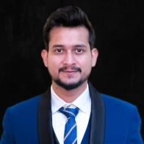
Rakshit Sharma, Salesforce Solution Architect
Collaborate with cross functional teams including sales, finance, IT, and business stakeholders to gather requirements, prioritize initiatives, and align CPQ & Billing solutions with business goals and objectives.
Provided expertise for projects in diverse environments including NA, Europe, and APAC.
Experience of implementing solutions in different industries – Hi-Tech, Retail, Network Security, Healthcare and Consumer Lifestyle.
Involved in various stages of Software Development Life Cycle including analysis, requirement gathering, development, configuration, enhancements, testing, deployment, and maintenance of applications.
Expertise in designing and optimizing the Salesforce data model for CPQ and Billing applications, including custom objects, fields, relationships, and validation rules.
Proficient in defining billing, invoicing, and subscription management in Salesforce to automate the billing process and improve revenue recognition with strong knowledge of integrating with other systems such as ERP and payment gateways.
Understanding of Salesforce security best practices, including role hierarchy, profiles, permission sets, and sharing settings to ensure data privacy and compliance with regulatory requirements.
Proficient in building custom reports and dashboards in Salesforce to track key performance indicators, monitor sales pipeline, and analyze billing metrics for business insights.
rakshit.sharma@brillio.com
Toronto, Canada
Core Skill Sets
Salesforce Solution Architect with 8 years of industry experience including: Salesforce CPQ | Salesforce Billing | Sales Cloud | Service Cloud | Digital Experience | Conga Document Generation | Apex | Flows | Integrations | Salesforce DX | Lightning | Jira| Azure DevOps | GitHub | Gearset |Copado | DocuSign | Process flows | APIs
Certifications
Salesforce Certified Administrator
Salesforce Certified App Builder
Salesforce Certified Platform Developer I
CPQ Specialist Certification
Apttus CPQ 201
Project Experience
Automation Anywhere/Ivanti/Zendesk
Collaborate with cross functional teams including sales, finance, IT, and business stakeholders to gather requirements, prioritize initiatives, and align CPQ & Billing solutions with business goals and objectives.
Communicate project status, risks and issues to stakeholders and ensure timely delivery of milestones.
Responsible for designing and guide the development team implementing salesforce CPQ & Billing solutions, including gathering requirements, creating solution design, and configuring CPQ components such as products, price rules, discount schedules and quote templates.
Helped the dev team implementing Salesforce Billing Configuration, Invoicing, Payments, Dunning, and Collection processes.
Understanding and designing Revenue Recognition, Schedulers, Allocations, Refunds, and financial transactions within Salesforce Billing and helped in integrating Salesforce CPQ/Billing with external systems using Rest APIs.
Recent Roles
Salesforce CPQ & Billing Solution Architect
Salesforce CPQ Specialist
Salesforce Technical Lead
Salesforce Business Analyst
Key Clients
Zendesk
Ivanti
Automation Anywhere
Silicon Experts
Ciena
Philips
©2024 Brillio | 11

Slide 12
Implemented guided selling features within Salesforce CPQ to assist sales reps in product selection and configuration. Configure product rules, dependencies, validations, and guided selling scripts to guide users through the quoting process.
Design document generation tools to automate the creation of proposals, contracts, and other sales documents.
Conducted thorough testing of CPQ configurations and workflows to validate functionality, data accuracy, pricing calculations, and system integrations. Perform unit testing, integration testing, and user acceptance testing to identify and address issues proactively.
Created comprehensive technical documents including solutions designs, configuration guides, data models and release notes.
Silicon Experts/Ciena
Manage CPQ & Billing implementation project from initiation to completion including project planning, task prioritization, resource allocation, and progress tracking.
Design product structure, pricing, discounting, relationships, bundles, and constraints to ensure accurate and dynamic quoting based on customer needs.
Design customized documents with dynamic content generation based with branding, logos, terms and conditions, product descriptions, pricing details, and optional line items as per customer requirements.
Design and define approval processes for quotes, contracts, and discounts including approval criteria, approval steps, escalation rules, and notification workflows to ensure compliance, governance, and accuracy in quote approvals.
Helped the customer to design and implement guided selling features within Salesforce CPQ to assist in product selection and guide users through the quoting process.
Develop training materials and conduct training sessions for sales teams, administrators, and stakeholders on Salesforce CPQ functionality, processes, and best practices. Foster user adoption by providing ongoing support, troubleshooting assistance, and continuous education.
Monitor CPQ usage, analyze performance metrics, and gather feedback from users to identify opportunities for optimization and enhancement.
Supported ongoing maintenance and optimization of Salesforce CPQ & Billing based on feedback from end-users and stakeholders.
Philips
Designed, developed, and deployed the Custom objects, Custom tabs, Validation rules, OWD and Security setup to suit to the needs of the application.
Set-up Email-To-Case, Web-to-Case, Case Management, Knowledge Management, Case Support Process/Settings, Reports and Dashboard.
Service Cloud Knowledge Articles, Case Assignment Rules, Escalation Rules, Approval Rules, Auto Response Rules, Macros, Entitlement & Milestones.
Worked on Apex Classes, Apex Triggers, Visualforce, Batch Classes, Test Classes, External Objects.
Configured Salesforce Sharing settings with OWD, Profiles, Permission Sets etc.
Integrating with external systems for Accounts and Products sync within the org.
©2024 Brillio | 12

Slide 13
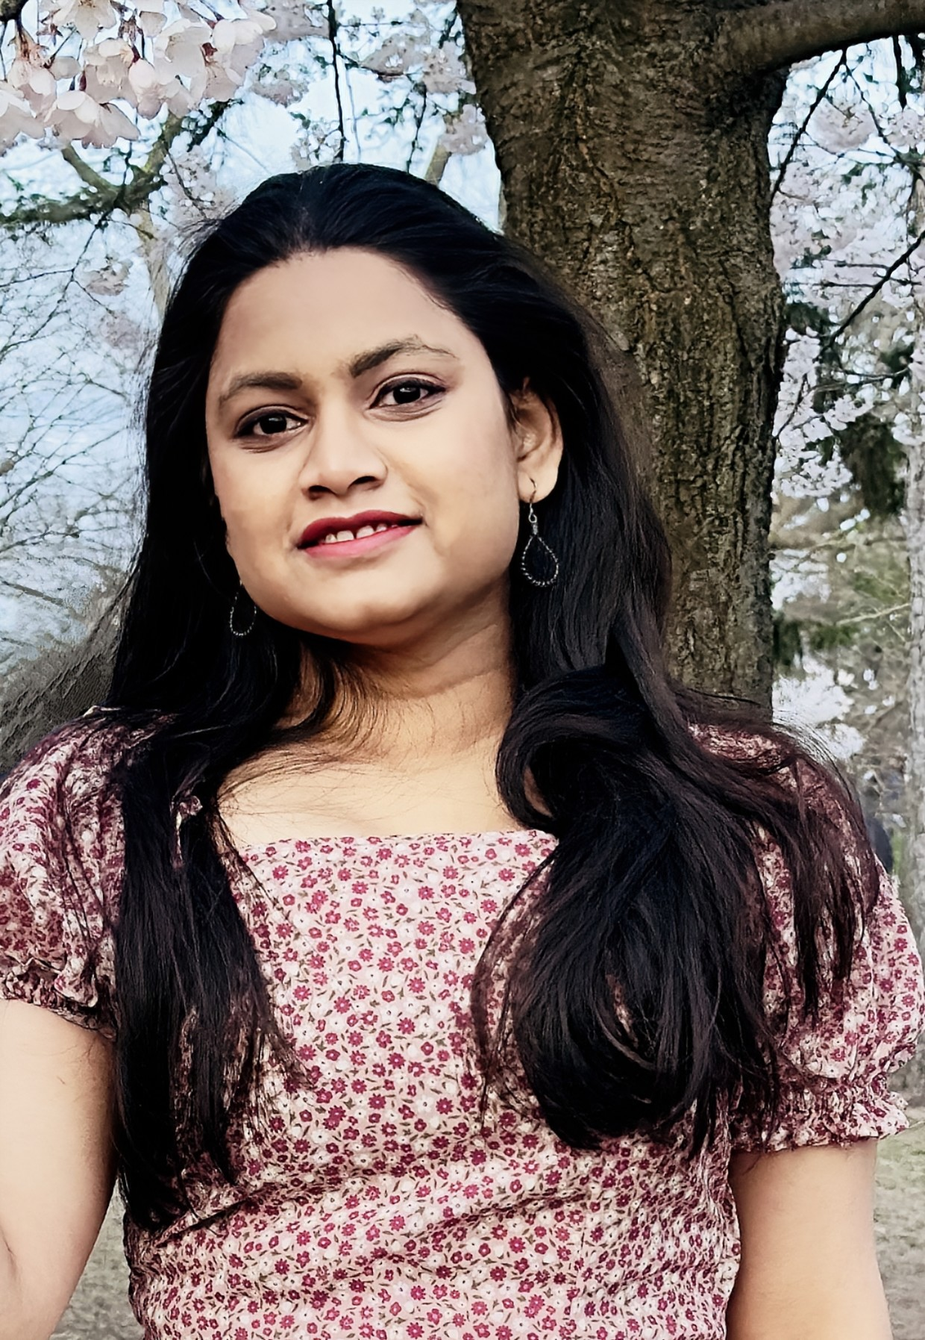
Sonali Sahu, Development (Salesforce)
Salesforce Developer with more than 6 years of industry experience
Proficient in Salesforce Development, Apex, Admin, Lightning Web Components, Salesforce integrations, Flows, Debugging and some of other Admin tools.
Experienced with Copado and Flosum for continuous Integration, deployment and release management.
Sonali.Sahu@brillio.com
Toronto, Canada
Project Experience
Client : LeafHome
Role: Sr. Salesforce Developer
Responsibilities:
Developed custom solutions and extensions for Salesforce field Service Lightning (FSL) platform using Apex, Visualforce, Lightning Components, Flows, and JavaScript to meet specific business requirements and enhance field service operations.
Understanding of Salesforce security best practices, including role hierarchy, profiles, permission sets, and Apex sharing and sharing settings to ensure data privacy and compliance with regulatory requirements.
Configured and customized FSL objects, including Work Orders, Skill and Work type, Service Appointments, Assets, and Service contracts and Service Territories, Operating Hours, Service resources, Contract Line Items and Entitlements, Cases and Scheduling policy to meet client requirements.
Designed and implemented custom solutions using Field Service Lightning to streamline work order management, asset tracking, territory, Field service mobile App and Field service scheduling and optimization by Dispatcher Console with Gantt chart and Scheduling Optimizer.
Collaborated with cross-functional teams, including business analysts, architects, and administrators, to gather requirements, design solutions, and ensure successful delivery on time.
Worked closely with stakeholders and end-users to gather feedback, iterate on solutions, and drive continuous improvement and innovation in FSL implementations.
Worked on Salesforce enhancements and bringing existing code into best practices including security, scalability, and Salesforce limits.
Did requirement and code analysis to complete enhancements required in client system efficiently.
Client : Zendesk
Role: Sr. Salesforce Developer
Responsibilities:
Created approval processes for quotes, contracts, and discounts including approval criteria, approval steps, escalation rules, and notification workflows to ensure compliance, governance, and accuracy in quote approvals.
Designed and implemented subscription management processes, including billing schedules, renewal automation.
Analyzed existing code and find the optimal solutions for the requirement mentioned in helpdesk tickets.
Did admin/dev work as and when need to achieve the requirement.
Core Skill Sets
Apttus CPQ
Sales Cloud
Service Cloud
Salesforce CPQ
Field Service Lightning
JIRA | Devops
Copado| GIT | Flosum
APEX
Visualforce
Javascript
Aura Components
Lightning Web Components
Flows
Zuora integration
Conga Templates
Postman
X-Author
Remote Site Setting
Sharepoint Integration
ChatBot Integration
Conga Document Generation
©2024 Brillio | 13

Slide 14
Client: Box
Role: Salesforce Developer
Responsibilities:
Performed analysis and coordinated with other developers to design and code systems.
Analyzed code and corrected errors to optimize output.
Integrated Salesforce CPQ with subscription billing platforms such as Zuora to enable seamless end-to-end subscription management.
Designed and developed Lightning Components and LWC for custom user interfaces and enhanced user experience within the Salesforce platform.
Set-up Email-To-Case, Web-to-Case, Case Management, Knowledge Management, Case Support Process/Settings, Reports and Dashboard.
Case Assignment Rules, Escalation Rules, Approval Rules, Auto Response Rules,.
Configuration of email to case setup, creation of fields, process builder, custom labels, custom metadata, LWC (Lightning web components). Different APIs payloads for connecting with salesforce from Mulesoft. Developed Apex classes to interact with components and attain functionality.
Built Platform Events and Implemented Salesforce File Connect to integrate with SharePoint.
Working knowledge on Remote site setting.
Involved in fixing production code bugs and assisting end users for production issues.
Prioritized work effectively and handled multiple competing demands.
integrated Salesforce with third-party applications.
Product and service configuration with constraint rules, attribute rules.
Created bundle products, price list and pricelist line-items then migrated using X-Author Data Migration tool, Data loader.
Identified and developed process improvements that facilitated knowledge transfer to others.
We have developed several customized functionalities on top of Apttus CPQ functionality to fulfill the client's requirements
X-author conga template creation and modification.
Client: Confluent
Role: Salesforce Developer
Responsibilities:
Product and service configuration with Price rules, Order forms, Quote templates, Approval Rules, Product rules, Attributes, Contract, Bundle Configuration, Lookup Queries, Discount Schedule, Option Constraints, CPQ Quote Document Generation, QCP Scripts, QLE experience, Subscriptions, Amendments and Renewals.
According to business requirements, created products, priced them, and validated them on the cart page.
Project Management with Team Leading, Problem Solving, Conflict Resolution, Teamwork and Collaboration, Adaptability, Critical
Conducted code reviews and implemented coding standards, ensuring high-quality and maintainable code.
Estimated work hours and tracked progress using scrum methodology.
Created fields, objects, validation rules, Workflow, Rules, Salesforce advanced approval process, Reports, Dashboards, Custom labels, Approval processes, Batch apex, lightning web components.

